Slide 1
Progress Update
Lin Yuling - Data Science (Credit) Intern

Slide 2
28 Aug - 4 Sept, week 4
Run accept dataset & GPS dataset 1M 5M using toad, book codes and ds codes, record time and output
Generate visualisations for outputs to compare binning performance.
For the 3 models, compare customisable parameters and issue handling, record in a table -- checked toad & DIY, need to look at ds woe_transformer class
Find better output measurements from books - better be quantitative

Slide 3
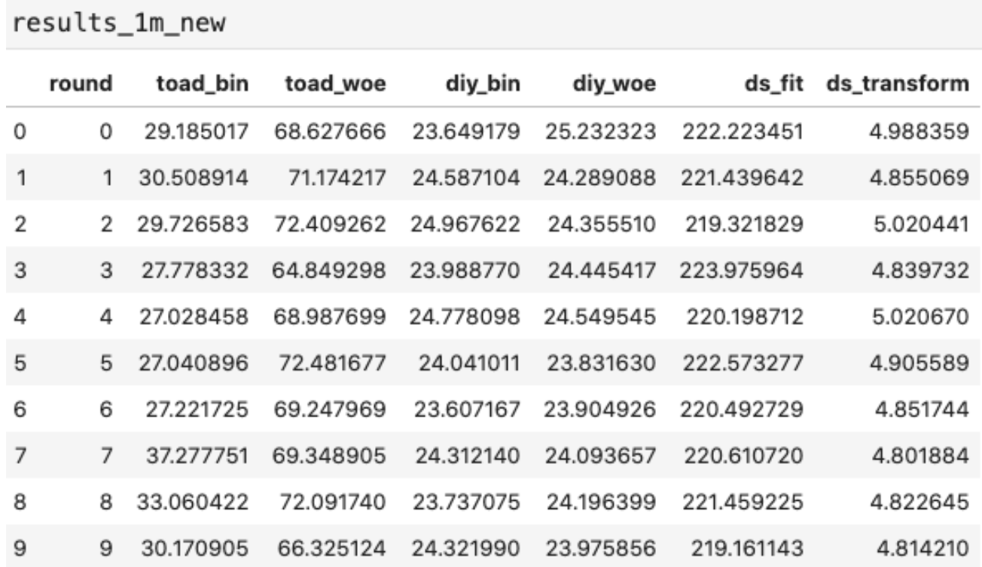
28 Aug - 4 Sept, week 4
Total time: DS scorecard code > toad > book DIY functions -- accept dataset 1 M
Note: WOE calculation happened in _woe for toad and diy, but in _fit for ds scorecard
Dataset: 1M rows, 19 continuous variables

Slide 4
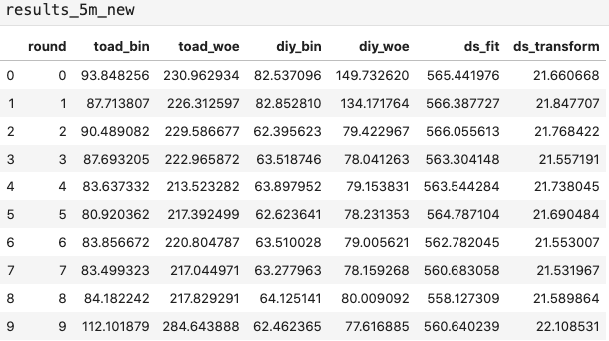
28 Aug - 4 Sept, week 4
Total time: DS scorecard code > toad > book DIY functions -- accept dataset 5 M
Note: WOE calculation happened in _woe for toad and diy, but in _fit for ds scorecard
Dataset: 5M rows, 19 continuous variables

Slide 5
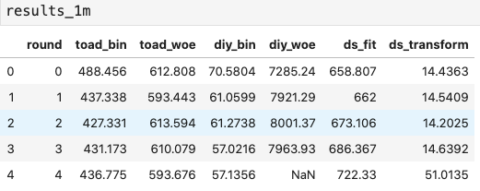
28 Aug - 4 Sept, week 4
Total time: book DIY functions> toad > DS scorecard code > -- GPS dataset 1M
Bin time : DS scorecard code > toad > book DIY function
Note: WOE calculation happened in _woe for toad and diy, but in _fit for ds scorecard
Dataset: 1M rows, 37 continuous variables

Slide 6
28 Aug - 4 Sept, week 4

Slide 7
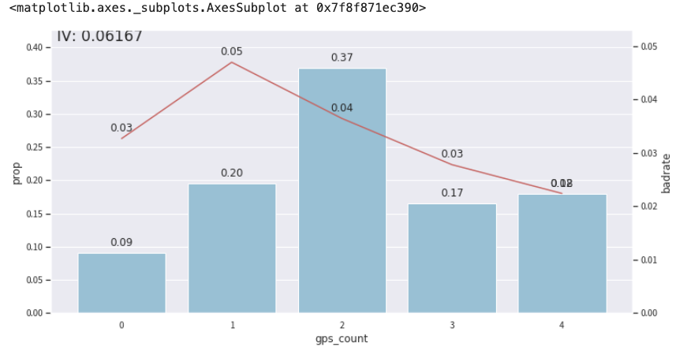
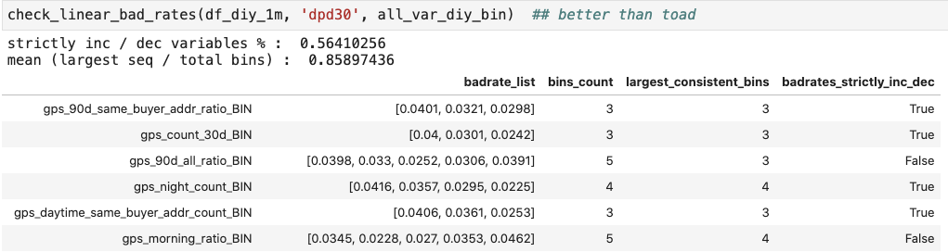
28 Aug - 4 Sept, week 4
2 & 4 Goodness of output -- functions to generate evaluating DFs

Slide 8
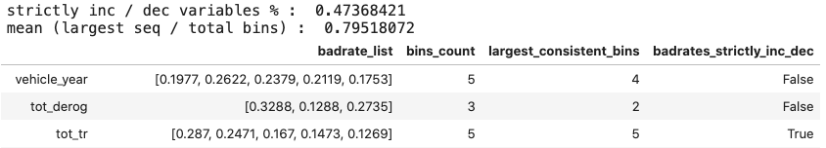
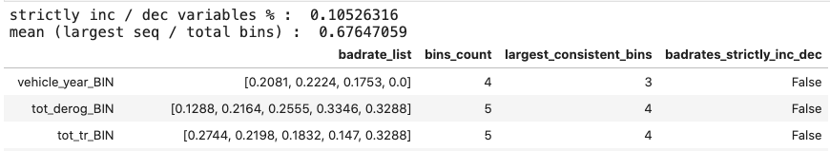
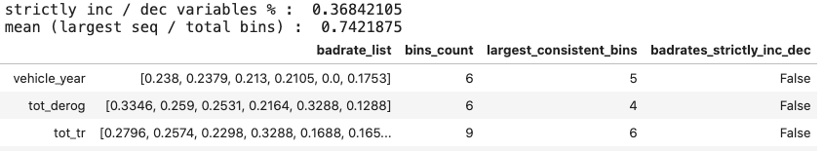
28 Aug - 4 Sept, week 4
2 & 4: Goodness of output -- functions to generate evaluating DFs (accept)
diy < ds < toad
Toad
DIY
DS scorecard

Slide 9
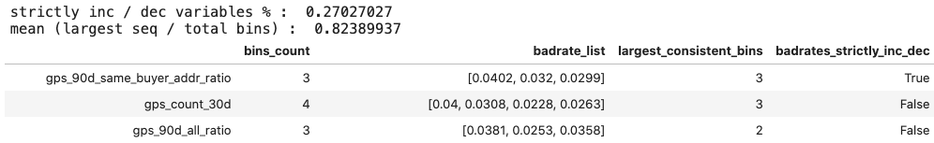
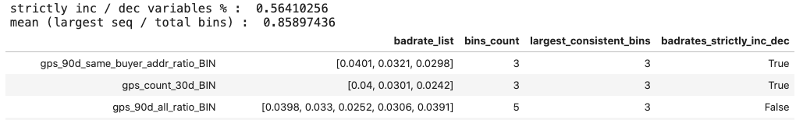
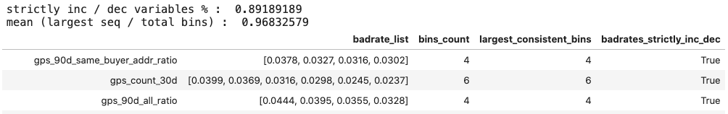
28 Aug - 4 Sept, week 4
2 & 4: Goodness of output -- functions to generate evaluating DFs (GPS 1M - run 1)
Toad < diy < ds
Toad:
DIY:
DS scorecard:

Slide 10
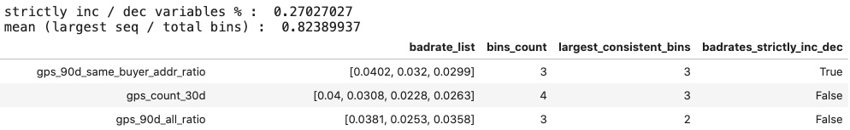
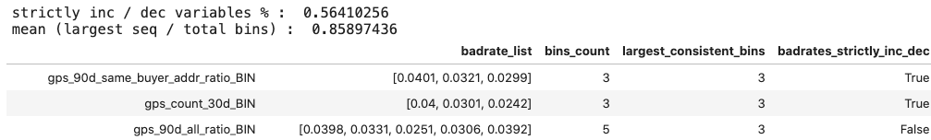
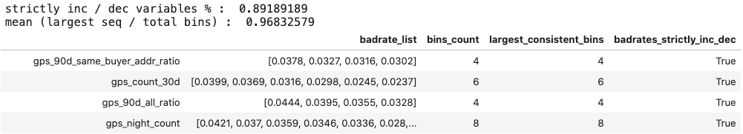
28 Aug - 4 Sept, week 4
2 & 4: Goodness of output -- functions to generate evaluating DFs (GPS 1M - run 2)
Toad < diy < ds
Toad:
DIY:
DS scorecard:

Slide 11
28 Aug - 4 Sept, week 4
2 & 4: Goodness of output -- functions to generate evaluating DFs
-Qn: should we use some metrics to show how badrates are different across bins?
Eg standard deviation ?

Slide 12
week 5 - week 8
Plan for this week:
Understand binning optimisation strategies
- why toad and DIY faster?
- sacrifice quality ?
- understand book codes -> draw connection to ft_eval_helper
Test and run ft_eval_helper in notebook
Understand the functions
Write documentation along the way
Insert print() under each functions see the flow
Flowchart that shows data flow & function calls
Optimise with toad / book codes
Do not lose too much quality

Slide 13
7-11 Sept, week 5
取得的进展：
自定义函数，分析代码function call → 有python library
了解代码function call，flow chart
和cheyu答疑 + 作者comment → 确定分箱逻辑，优化方向
本周计划：
利用 library 完善functional call flow chart, + Data flow (input output)
basic documentation
学习 Python multi-processing，试拆解简单的 for loop
Pandas - parallel - 尽量内部实现 - 不要自己写
Dask
做成 package -- 三种 方法都实现
先一种：留一个口
Min_sample：percentage 和 绝对数量分开 - 如果都设都要满足

Slide 14
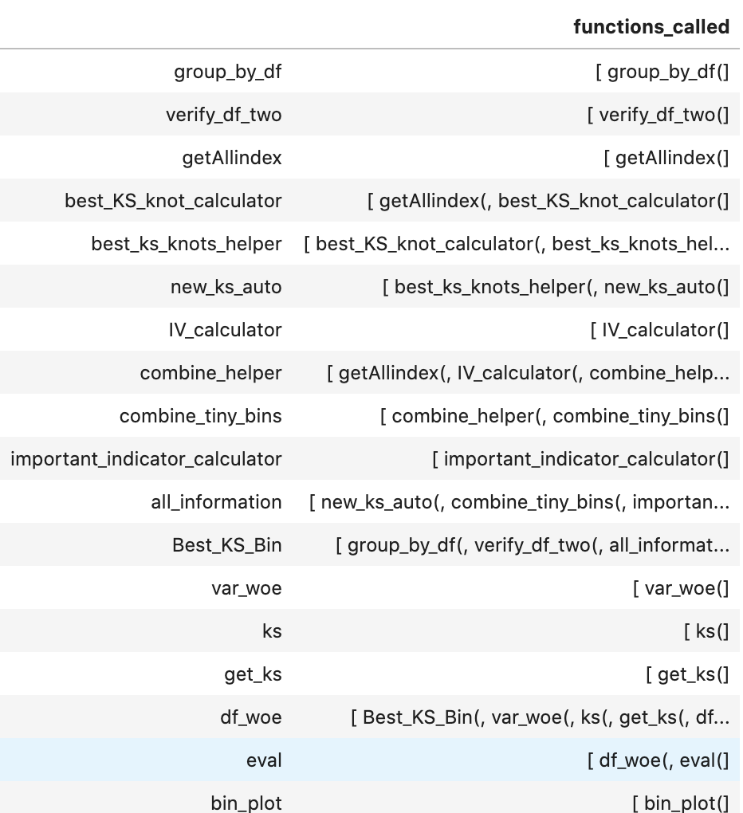
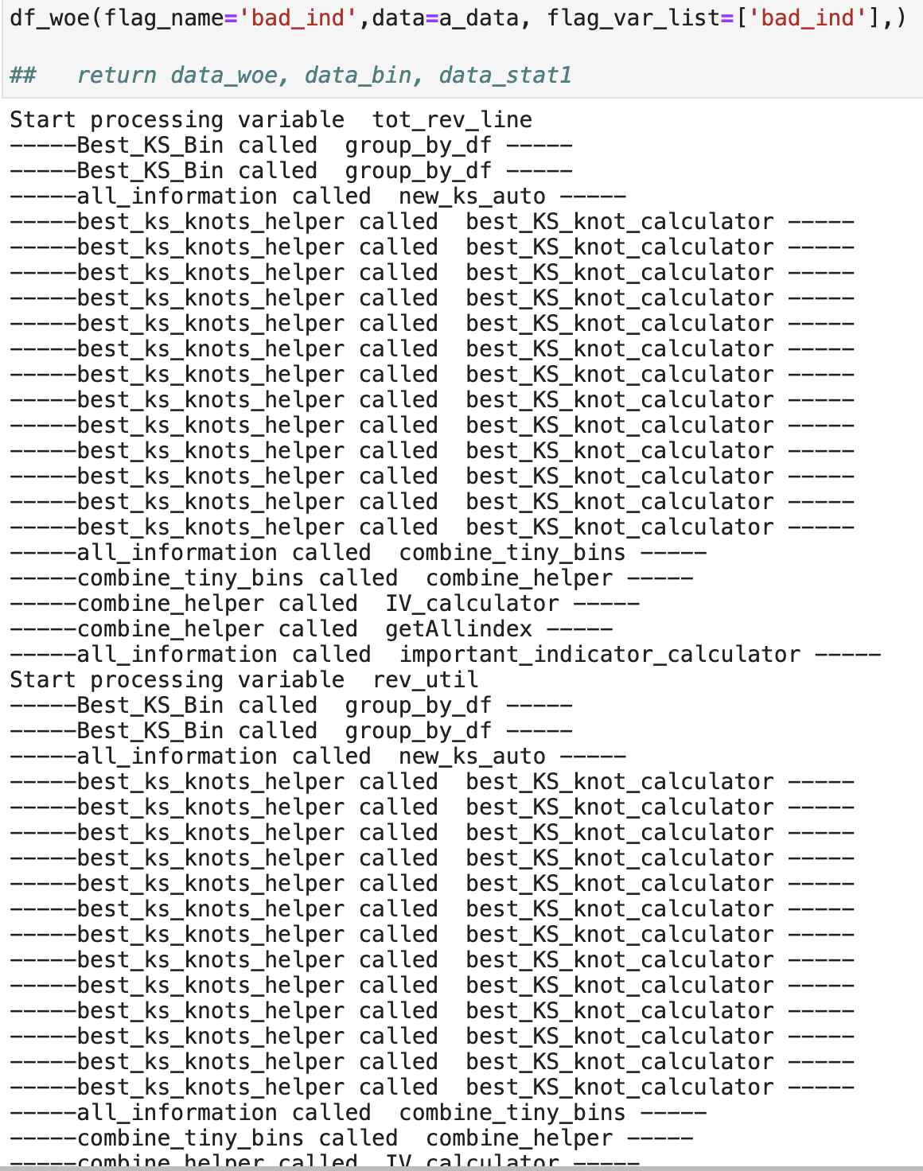
7-11 Sept, week 5
确认function call 关系和试运行中的顺序（data：1 flag 2 features）

Slide 15
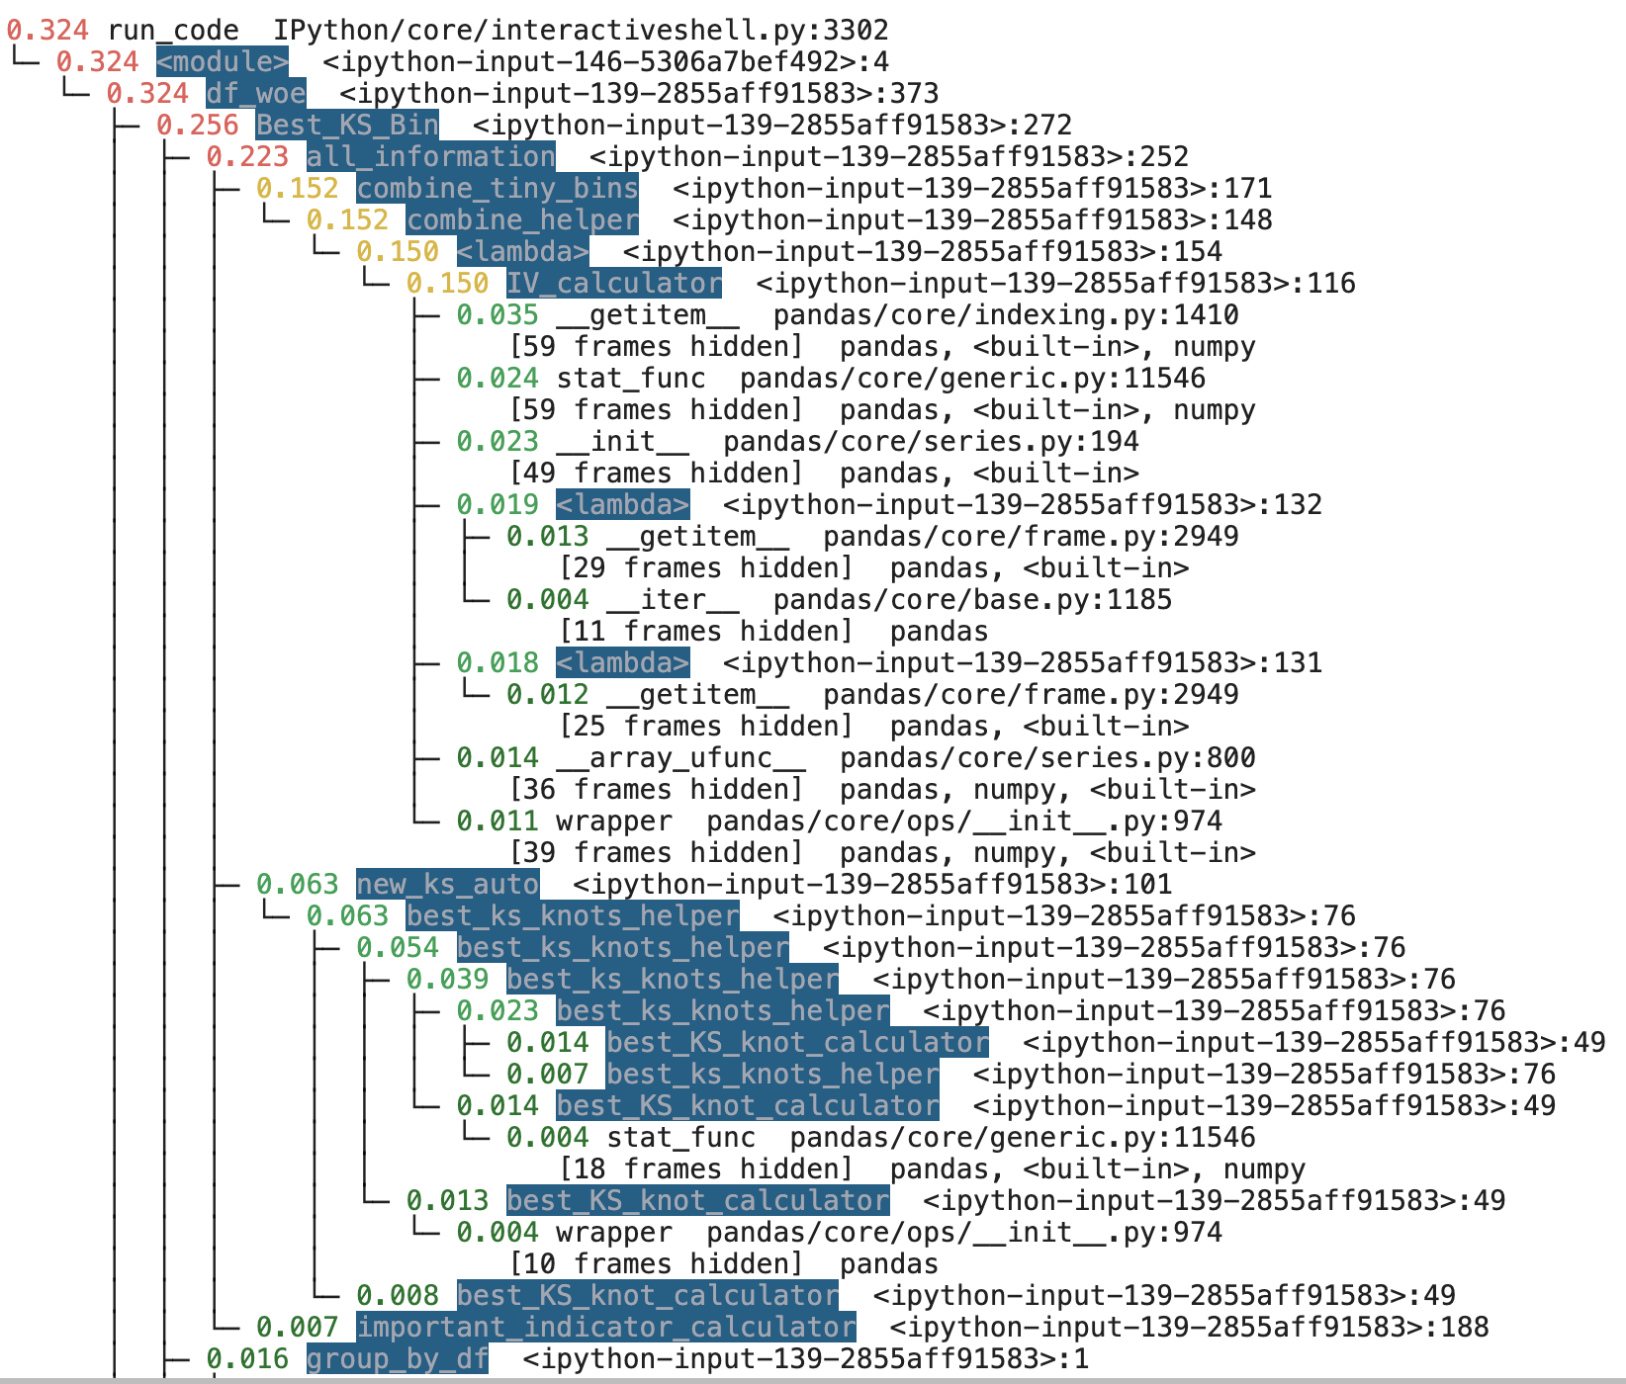
7-11 Sept, week 5
2. Flow chart
https://drive.google.com/file/d/1fXjVR_McPPEvwe9QGRl3lGLatvHaPC8Q/view?usp=sharing
有其他的library 比如 pyinstrument
更具体，也可以分析时间
利用这些library完善flowchart
Include data flow

Slide 16
7-11 Sept, week 5
3. 答疑
确定参数定义-- 最后尽量统一命名
分箱逻辑
花时间的部分
都是 unique value 连续变量找切点
很多feature时，for loop
下一步：每周5代码review
Multi-processing -- 不急
仔细研究分箱部分代码 - documentation
利用library分析借鉴toad 和书本代码
主要是 自己写一个版本的 代码--逻辑清楚 fit transform 这些
结合书 和自己的
风格借鉴书
单调应该是可配置的参数 0 / 1
每周新功能 - eg 等频 tested，然后等距，把框架写出来，保证每周都是产出
看效率对比
Cat 变量也要pass list

Slide 17
14-18 Sept, week 6
代码初步 - 等频初始化 - mapping - 计算卡方
Fit / tranform
Test - 指定的x 目标y - 1 次 / 100 次 量化： 时间 + 对比书 output
细致的代码
写伪代码
自己代码过程的问题：
Initialise时简单一些 等频 vs 等距
等频确保每箱都有足够数量，但是可能和outlier分到一箱
等距会遇到空箱 - 书上用等距init 后再用函数解决空，小箱
>95% outlier?
Missing value?
理想的初始化箱数 - 越多越好慢慢合并？书默认0.01
书和ft_eval_helper 都属于自上而下找切点
每一轮都要考虑很多点
如果自下而上合并，可以只利用meta data
用多少significant value 合并？ 如果Chi2 都很高怎么办？
两箱Chi2 相加 = 合并后的 Chi2？

Slide 18
Week 7
问题和目标
实现更多分箱办法 -- 学习书上融合成一个method，通过param来选
过程中使用更快的data structure？目前pandas 可能影响速度
Object 拥有 attribute 的必要性
Initial bins 合适的数值？- 10-100
强制bad rate单调性 -- 找到效率高的算法 -- 自己代码有
像 ft_eval_helper 一样算出并储存 IV WOE 这些
一个function 做一件事
让其他function 来算
主要进展
OO 模型 VarBinHelper: （目前方法只有卡方）
等距初始化 binrate = 0.01
初始mapping
计算卡方 - 选择 Chi2 最小2箱 合并 → loop
结合以上3步 fit_single_x
transform_single_x
fit
transform
Performance：之前使用的 gps 1m dataset
Fit 所有连续变量 113 秒
Transform 16 秒
Fit 时间受 initial bin rate 影响：O(n)
也受最大箱数影响

Slide 19
Week 7
主要进展
Cat fit + transform
Data: 19 continuous + 4 cat columns
Performance：之前使用的 accept 1m dataset
Fit 所有cat变量 7 秒 (4 columns)
Transform 2 秒
5m accept
Fit 时间受 initial bin rate 影响：O(n)
也受最大箱数影响
Fit 35 sec
Transform 2 sec
Compare: toad + old codes ONLY cat

Slide 20
Week 9-10
 | Toad fit | Toad transform | Helper fit | Helper transform | Ft_eval fit | Ft_eval transform
Accept 1M 4 cat features | 6.62 | 1.26 | 7.97 | 2.89 | 12.35 | 17.73
df_score 1.1M 6 cat features (score 4dp as str) | 98.47 | 16.17 | 104.77 | 8.51 | 120.22 | error
Accept 1M all 23 features | 41.51 | 2.12 | 72.37 | 10.054 | 243.24 | 1046.24
df_score 1.1M all features (6 cat) | Set to (1000, 5000) t= 786.44 | 2.38 | 62.70 | 14.9
df_score 1.1M all features (6 cat) | Set to (100, 999) t= 23.66 | 2.42 | 59.55 | 14.81
主要进展
实现限制有效数位
强制单调性（0 or 1 turn）
时间对比
等距分箱+合并小箱
0.005 -- 200 -- 60
自上而下框架 , IV

Slide 21
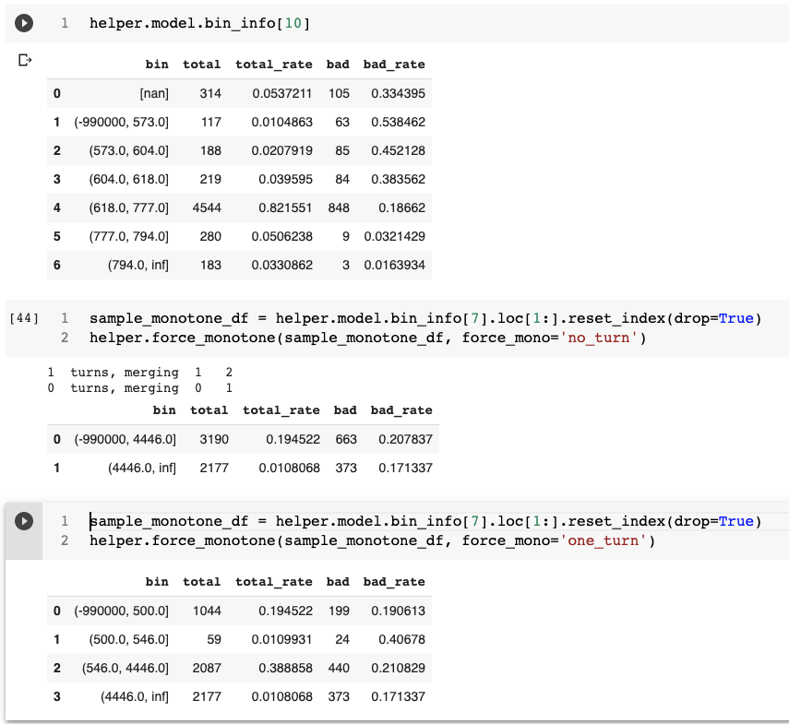
Week 9-10
强制单调

Slide 22
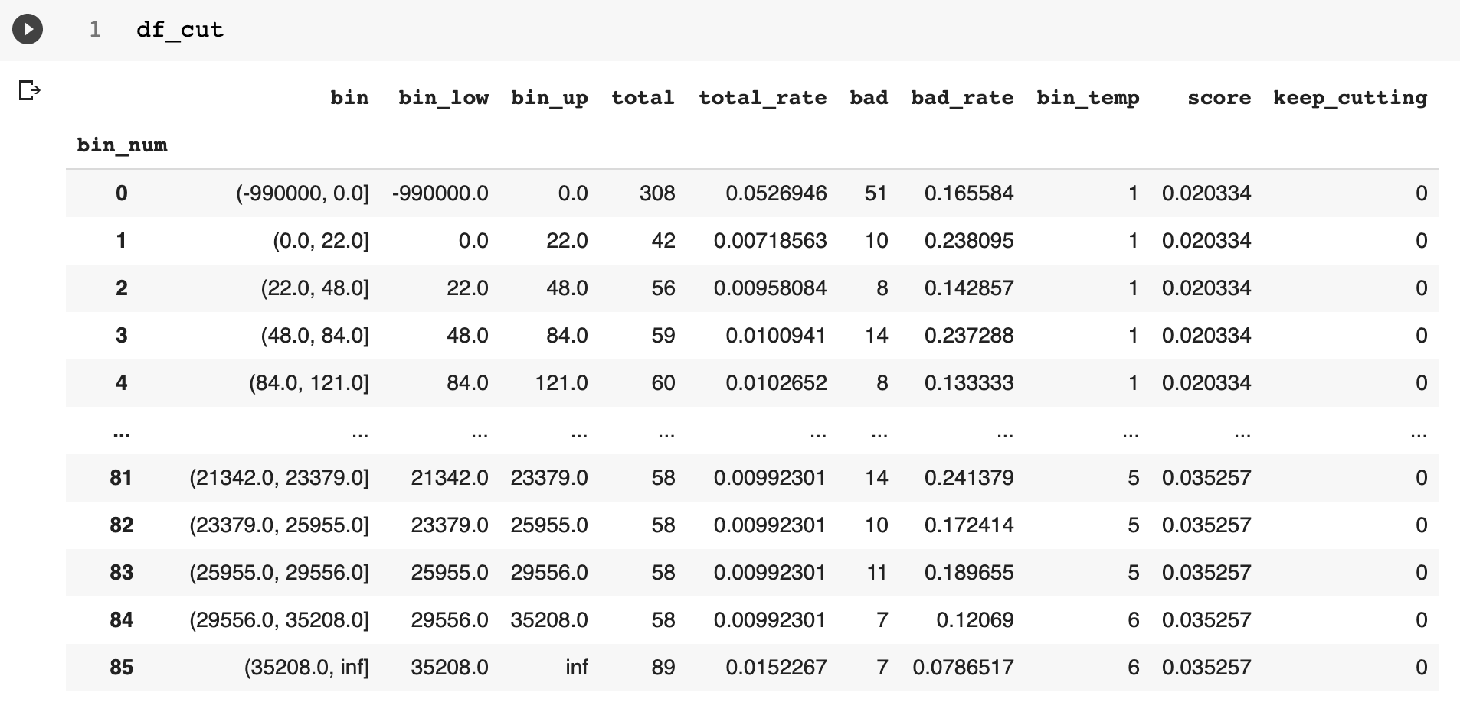
Week 9-10
自上而下初始化

Slide 23
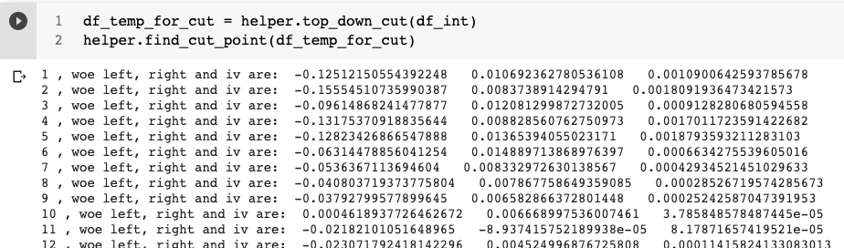
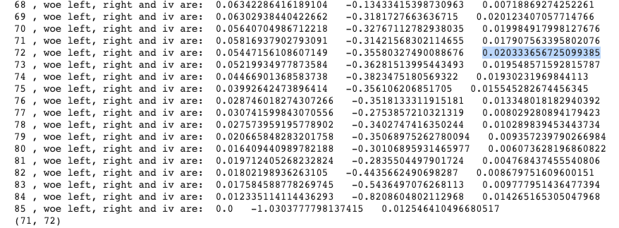
Week 9-10
WOE IV 计算， 找切点

Slide 24
Week 9-10
自上而下 流程
cut_top_down() init bins 1,2,3,4,5 ………8. 78,79,80… ALL labelled 0 bin_size = 5
cut_and_evaluate() call find_cut_point() and decide whether to split based on score
find_cut_point() use methods like iv to find cut point and calculate score
00000000000000000, 1111 111111,
最好有流程图 + 例子，核心变量
合并前后， cut point
Init 用 df.groupby()
df_stat = df.groupby('woe').agg(total=('label', 'count'),
bad=('label', 'sum'),
bad_rate=('label', 'mean'))
尽量 for loop 变成 pandas 的 df 的 运算 -- 前期实现逻辑，后期改成pandas（难读懂）
dask

Slide 25
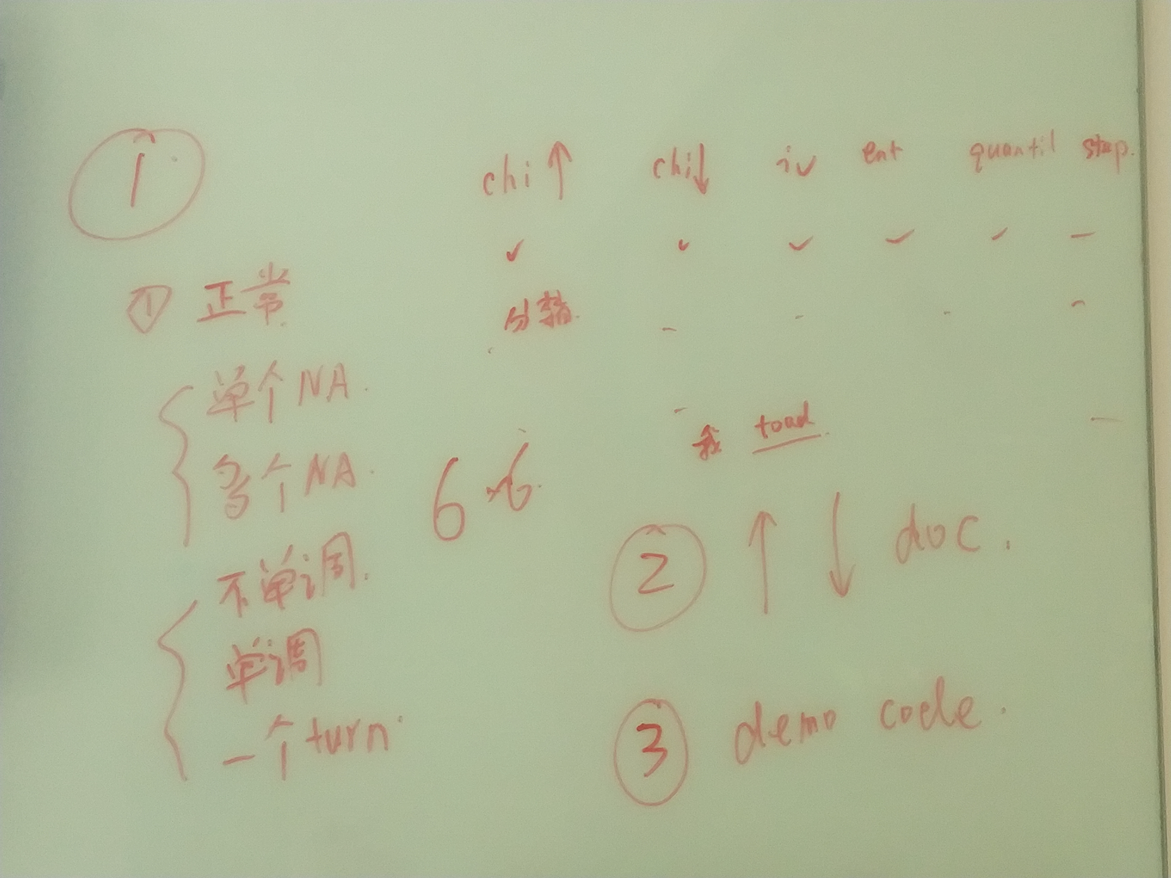
Week 11
主要进展：
完成 自上而下 高层 fit，超过 max bin 会停止
Iv, chi2_cut method 的 时间测试
iv 和 chi2 ，chi2_cut 的 output 对比
-- quantile, step
-- force mono 1 turn VS 0 turn VS no force
-- try -990001, -990010 …….， 单个 NA， 多个 NA，
-- can choose merge -999999 … into 1 bin missing = “merge”
Skewed dataset 实验
已知问题 黑色是已解决
应该在最高层包括NA箱的情况下，最后计算 bad rate 和 total rate
Equal dist init merge small bin has error in merging left and right
Give error when specified cat column name is not found
Method = iv 有时箱不是按照 x 值 从小到大排列的， 带有 inf 的最大箱跑去了最上面
Transform use df.map() df. f_feature.loc[:, c].replace(mapping_cat, inplace=True) ## dictionary, listed dict
New features：黑色是 已实现
Categorical 相等 bad rate 的箱合并
Chi2_cut
evaluate_model_bin_count( )
将部分for loop 改成 pandas.groupby().agg()

Slide 26
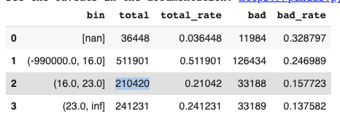
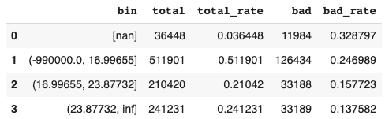
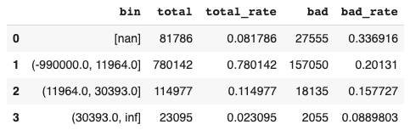
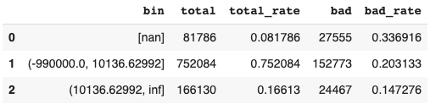
Week 11
等频和等距 init ， final output 对比
只改参数 init_method, method = “iv” （一般在bin_rate相等时，等频会给出更多初始箱, 因为等距有更多小箱）
左 等频 右 等距

Slide 27
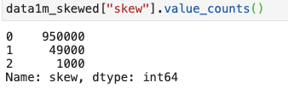
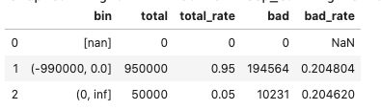
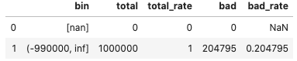
Week 11
Skewed column 实验
method = "iv", init_method = "equal_freq", bin_rate = 0.005, min_bin = 3, max_bin = 8
左 等频， iv： 0 ，1和2 右 等距， 所有值 1 bin
-- 连续变量如果一开始 unique values < max_bin， 或者很小，是否可以每一个 value 初始就是1箱 （当作类别）？b

Slide 28
Week 11
Method = “iv” 分箱 performance transform use df.map()
 | Toad fit | Toad transform | Helper fit chi_merge | Helper transform | Helper fit chi | Helper fit iv | Helper transform iv | Ft_eval fit | Ft_eval transform
Accept 1M 4 cat features | 6.62 | 1.26 | 7.97 | 2.89 | - | - |  | 12.35 | 17.73
df_score 1.1M 6 cat features (score 4dp as str) | 98.47 | 16.17 | 104.77 | 8.51 | - | - |  | 120.22 | -
Accept 1M all 23 features | 41.51 | 2.12 | 72.37 | 10.054 | 44.51 | 37.53 | 8.05 | 243.24 | 1046.24
df_score 1.1M all features (6 cat) | Set to (1000, 5000) t= 786.44 | 2.38 | 62.70 | 14.9 | 35.94 | 30.67 | 10.03
df_score 1.1M all features (6 cat) | Set to (100, 999) t= 23.66 | 2.42 | 59.55 | 14.81 | 32.51 | 28.77 | 9.78

Slide 29
Week 11
iv 对比 chi2，chi2_cut output
只改参数 method, init_method = “equal_freq”, 左右为2个不同feature, bin_rate = 0.01, min_bin = 3, max_bin = 15
Force_mono = “one_turn”
Accept 1M dataset 箱数/feature df_score 1.1M dataset 箱数/feature
Chi2 min, max, mean of bin count is : 2 16 6.375 min, max, mean of bin count is : 2 16 12.421
Chi2_cut min, max, mean of bin count is : 2 15 6.667 2 22 14.3157
Iv min, max, mean of bin count is : 2 15 3.9583 min, max, mean of bin count is : 2 15 4.73684
Chi2 （merge）的 max_bin 没有被强制，多了一个
Chi_cut 或 iv 的 max_bin 被超过是因为 二叉树当前一层就算超过 max 也会完成切分（为了公平？），之后停止
Chi2 cut 继续的条件可能过于宽松 ？ 现在是 chi2 > self.chimerge_threshold (3.84), 大的数据集 切分后 chi2 很容易达到 1000+ 2000 +

Slide 30
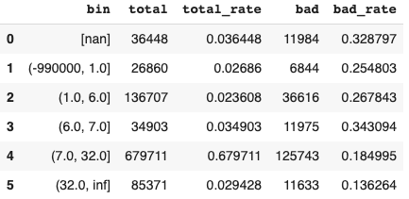
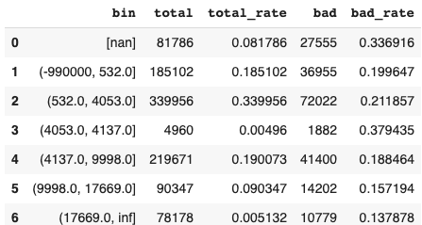
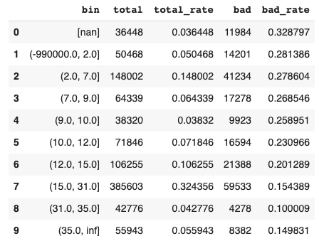
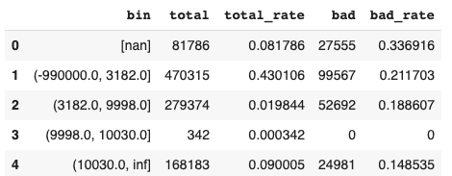
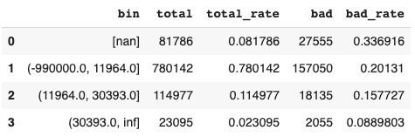
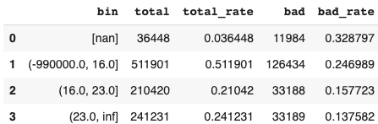
Week 11
iv 对比 chi2，chi2_cut output
只改参数 method, init_method = “equal_freq”, 左右为2个不同feature
Chi2
Chi2_cut
iv

Slide 31
Week 12
df.loc[ inclusive: inclusive ]

Slide 32
Week 12
主要进展：
NA_dict = {"vehicle_year":["1998.0"], "vehicle_make":["FORD","B50"]}
"tot_derog":[0.0,1.0] --》 不会发生
New features:
自上而下 method = entropy
确认chi, entropy 计算正确
Missing = “merge” 所有 NA value 去一个bin
用户 kwargs 可传 dict_na , 设置每个feature 的 特殊缺失值（对于类别型好用，连续变量 如果中间取一个 10，11，之后还没做到把这些value剔除， 可以用set_rule( ) 代替 ? ）## 变成 NA 再分
或者把值 挑出来
用户自定义区间 set_rules ( ) ，会备份fit( )的model，新的 bin_info 只有 bin column，其他bad_rate 这些目前是NA
测试：3 个 dimension：
Data：普通类别型，年份类别， Y/N 类别，多个-99xxxx以及na的连续，一个-99xxxx的连续，很多0一些1和2的，普通连续
分箱方式：chi_merge（自下而上合并）, iv, chi, entropy， 等距 init，等频 init，类别 init （init 后不进行下一步分箱）
单调性：强制单调，一个 turn，不采取强制
Data 通过不同的columns，实现，其他通过 params 里的 init_method, method, force_mono 实现
20 features，3 categorical， 17 numerical， 1,000,000 rows
Notebook：
https://colab.research.google.com/drive/1EK2lf-y787VAyY05Wkci44bniGkphwAx?usp=sharing
output一览表格：
https://drive.google.com/file/d/1bkhSBRX5pXdeyWx3DsuHdck4zap09At5/view?usp=sharing

Slide 33
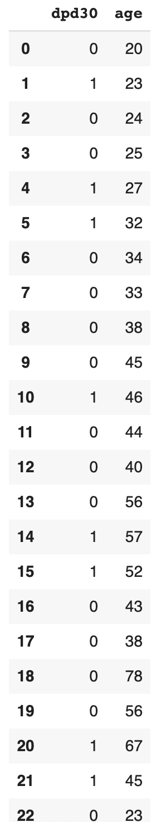
Week 12
After meeting - chi2 cut calculation verification
Small_df, 25 rows
Book:
M_value is 1.402019140989729
M_value is 0.20172841864018334
M_value is 2.4816176470588234
M_value is 1.175503095975232
M_value is 0.3236892583120205
M_value is 2.481617647058823
M_value is 2.4816176470588234
M_value is 0.26785714285714285
M_value is 1.3636363636363638
M_value is 3.484291443850267
M_value is 3.484291443850267
M_value is 4.976365546218487
VarBinHelper:
具体数字不同是因为，初始化分箱，以及切点找的不一样
line 477 debug chi2_cut, chi2 is 0.33121657754010725 , cut point is 1
line 477 debug chi2_cut, chi2 is 1.0921743697478994 , cut point is 2
line 477 debug chi2_cut, chi2 is 0.5727124183006536 , cut point is 3
line 477 debug chi2_cut, chi2 is 0.09212802768166066 , cut point is 4
line 477 debug chi2_cut, chi2 is 0.11710394385026748 , cut point is 5
line 477 debug chi2_cut, chi2 is 0.5644392372333549 , cut point is 6
line 477 debug chi2_cut, chi2 is 1.2343312324929978 , cut point is 7
line 477 debug chi2_cut, chi2 is 1.9077540106951871 , cut point is 8
line 477 debug chi2_cut, chi2 is 2.279820261437908 , cut point is 9
line 477 debug chi2_cut, chi2 is 2.315734188412207 , cut point is 10
line 477 debug chi2_cut, chi2 is 0.9301470588235297 , cut point is 11
line 477 debug chi2_cut, chi2 is 0.3729946524064171 , cut point is 12

Slide 34
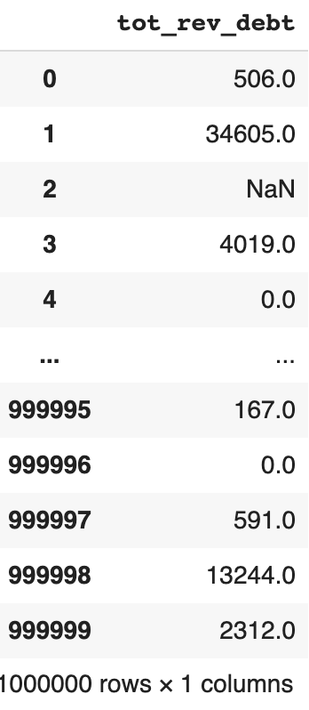
Week 12
After meeting - chi2 cut calculation verification
accept.tot_rev_debt
Book:
M_value is 391.4846220396137
M_value is 480.1411161173048
M_value is 585.9796571831832
M_value is 373.14567959690163
M_value is 128.82032376719596
M_value is 814.3010508666398
M_value is 715.6716454243654
M_value is 6658.070093431137
M_value is 25.22491718750553
M_value is 12.838965487196646
M_value is 39.9343272014892
M_value is 10.99680566233366
VarBinHelper:
具体数字不同是因为，初始化分箱，以及切点找的不一样
line 477 debug chi2_cut, chi2 is 221.23433471954738 , cut point is 1
line 477 debug chi2_cut, chi2 is 246.4390885704085 , cut point is 2
line 477 debug chi2_cut, chi2 is 149.81389934164287 , cut point is 3
line 477 debug chi2_cut, chi2 is 168.78005364820112 , cut point is 4
line 477 debug chi2_cut, chi2 is 328.2399541603232 , cut point is 5
line 477 debug chi2_cut, chi2 is 102.89493680698246 , cut point is 6
line 477 debug chi2_cut, chi2 is 76.63237110701003 , cut point is 7
line 477 debug chi2_cut, chi2 is 42.889227506567835 , cut point is 8
line 477 debug chi2_cut, chi2 is 28.400884479972873 , cut point is 9
line 477 debug chi2_cut, chi2 is 6.323146861140774 , cut point is 10
line 477 debug chi2_cut, chi2 is 9.18323225984641 , cut point is 11
line 477 debug chi2_cut, chi2 is 12.617147063416466 , cut point is 12
line 477 debug chi2_cut, chi2 is 8.997331839426904 , cut point is 13
line 477 debug chi2_cut, chi2 is 103.1531953560775 , cut point is 14
line 477 debug chi2_cut, chi2 is 143.22315205789488 , cut point is 15
line 477 debug chi2_cut, chi2 is 2139.316564600476 , cut point is 74
line 477 debug chi2_cut, chi2 is 1845.9116649763553 , cut point is 75
line 477 debug chi2_cut, chi2 is 1313.4428798323754 , cut point is 76
line 477 debug chi2_cut, chi2 is 1142.7021047252958 , cut point is 77
line 477 debug chi2_cut, chi2 is 1510.7823355846695 , cut point is 78
line 477 debug chi2_cut, chi2 is 854.5301628199248 , cut point is 79
line 477 debug chi2_cut, chi2 is 674.7201690430466 , cut point is 80
line 477 debug chi2_cut, chi2 is 876.1969849343942 , cut point is 81
line 477 debug chi2_cut, chi2 is 1176.1675493239466 , cut point is 82
line 477 debug chi2_cut, chi2 is 1334.4399237300834 , cut point is 83
cutting bin 0 cut at 69 score 2598.467447171721

Slide 35
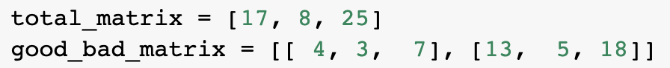
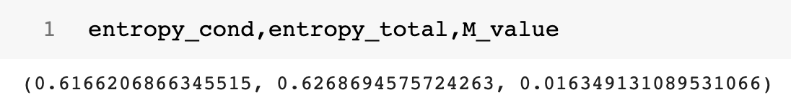
Week 12
Entropy calculation verification
Small_df, 25 rows , cut at 7
Book:
VarBinHelper:
line 519 debug entropy ---- entropy_cut is 0.016349131089531177 , cut point is 7 ent cond and ent total is: 0.6166206866345515 0.6268694575724264
不只是公式使用正确，在每个切点对比时，自己的 data structure 读取数据也经过验证
df.loc[include : include] -1 is exlude
loc[0:10]

Slide 36
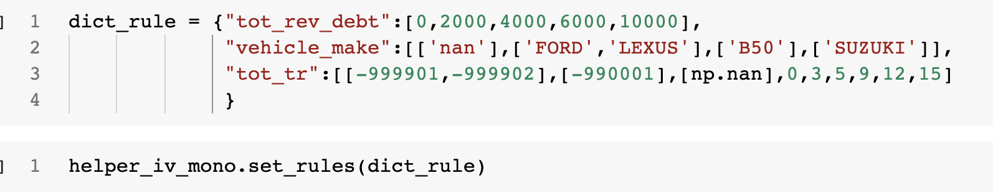
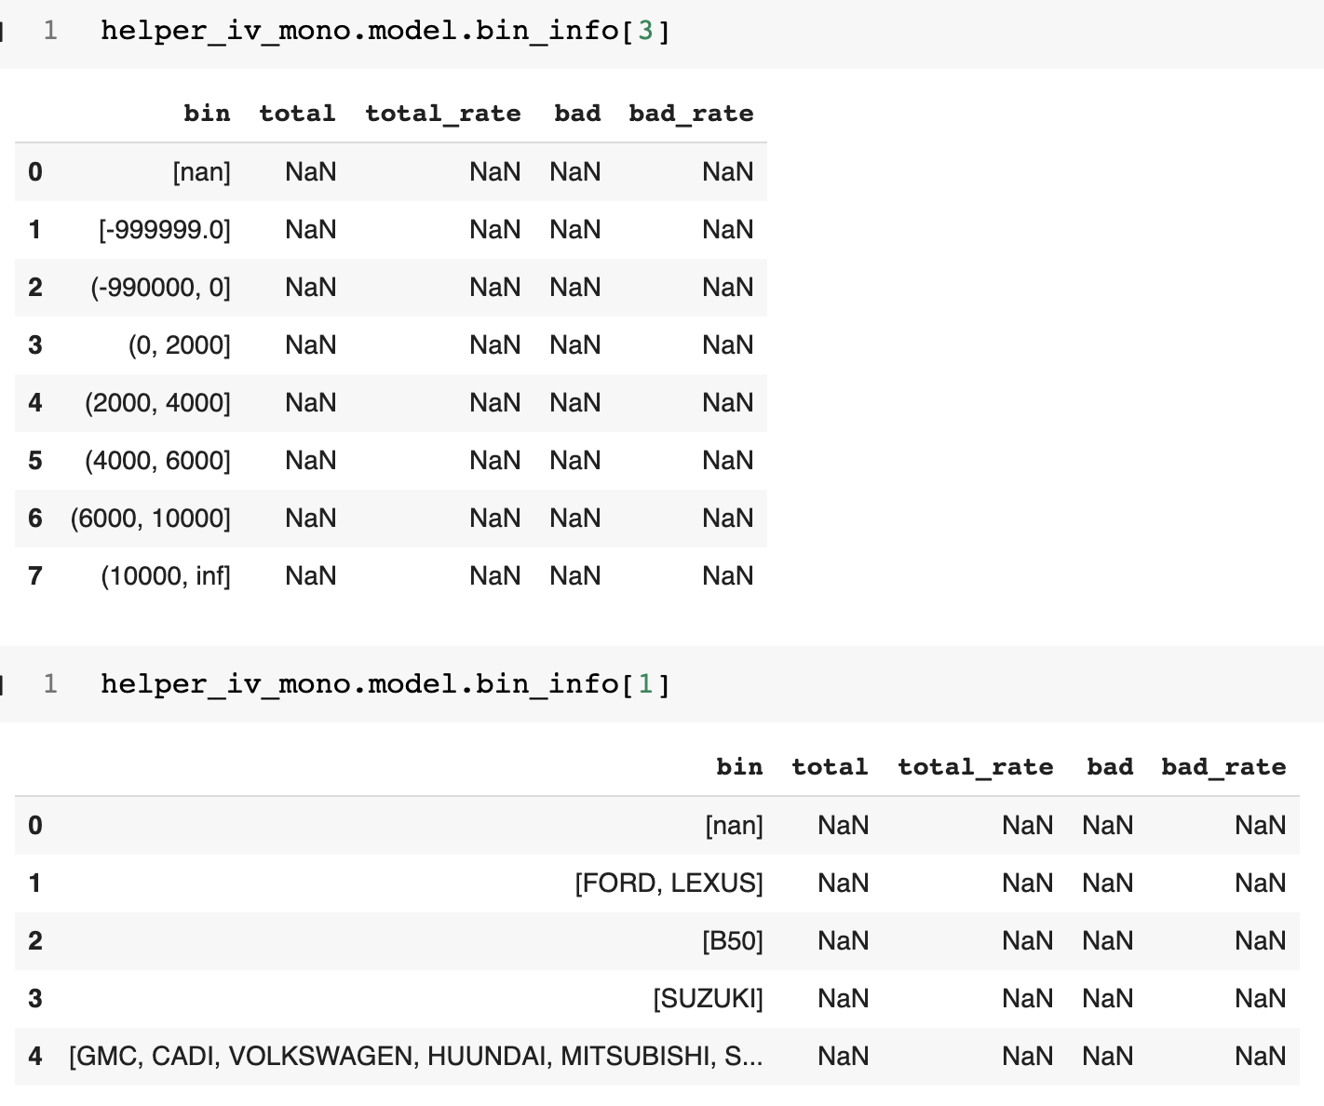
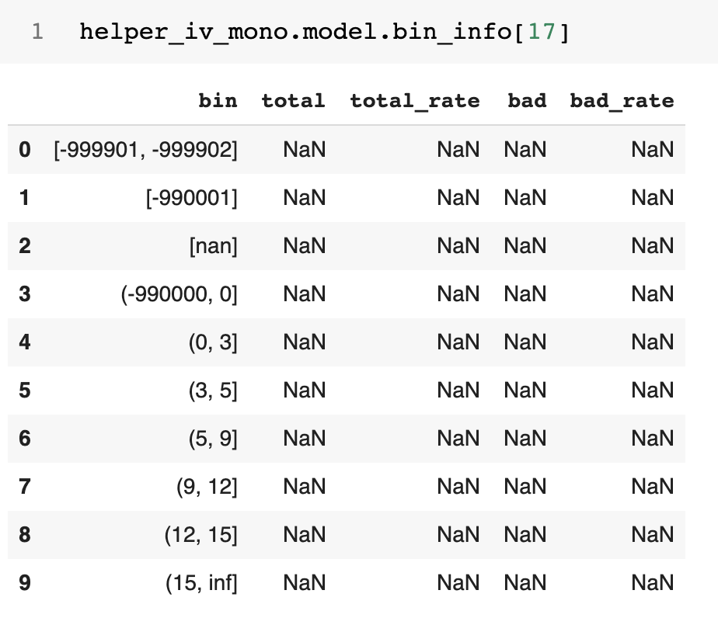
Week 12
set_rules() -- 是否需要再计算 bad rate 这些？

Slide 37
Week 12
Pandas.loc[ inclusive: inclusive ]

Slide 38
Week 14 成果汇报
不同分箱代码功能对比：
 | toad | 目前版本 | Intern 新版
单 missing value | ✔️ | ✔️ | ✔️
多种 missing values |  |  | ✔️
强制单调性 |  | ✔️ | ✔️
允许 1-turn 单调 |  |  | ✔️
手动分箱 |  |  | ✔️
精度调整 |  |  | ✔️
缺失值合并/单独一箱 |  | ✔️ | ✔️
Init 是否满足 min_sample

Slide 39
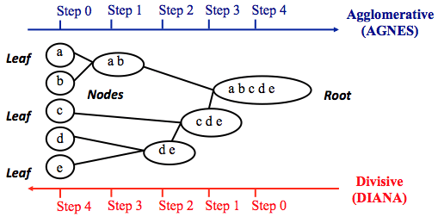
Week 14 成果汇报
Framework
 | 自上而下 cut | 自下而上 merge
适用 类别型 变量 |  | ✔️
适用 数值型 变量 | ✔️ | ✔️
Method | “iv”, “chi”, “entropy” | “chi_merge”
自下而上 合并
自上而下 切分
最小的单位（上图a,b,c,d,e …..）由等频/等距初始化得来
init_method = “step” or “quantile”

Slide 40
Week 14 成果汇报
Pseudo code： 自下而上 自上而下
Process missing value
Init smallest bin
While (condition)
Compute metrics
Merge bin
Update bin info
while not mono:
Merge two violated bins
Calculate woe,iv, merge features
Process missing value
Init smallest bin unit
label all bins as one bin
While (condition)
Compute metrics
split bin
Update bin info
while not mono:
Merge two violated bins
Calculate woe,iv, merge features

Slide 41
Week 14 成果汇报
不同 init_method
 | step（等频） | quantile（等距）
分箱数量 | 总数较多，少许箱由于重复 （eg sample很多1， 等频多箱都是1）自然会合并这些箱 总数略少于 1 / min_sample | 总数较少，等距，一些箱范围内sample 不够多 < bin_size，或者为空 总数比 step 少
切点取值 | 都是在feature中存在的值 | 一般带有小数，因为等距的distance 一般是小数，不一定在feature 中存在

Slide 42
Week 14 成果汇报
不同 method
 | iv | chi | entropy | chi_merge
分箱数量 | 切分较严格，只有iv 值增长才会切，分箱数量一般较少，靠近于 min_bin | 切分条件可控，最佳切点的 chi2 > threshold 就会切。threshold 越小，分箱数量越多。 使用默认threshold 分箱数量一般较多 | 切分较严格，只有 entropy 值增长才会切，分箱数量一般略多于iv | 分箱数量可控，取决于 threshold，最小chi2 值 < threshold 就会合并。threshold 越大，合并的可能性越高，分箱数量越小
时间 |  |  |  | 四种里较慢
验证正确性 | 和书本代码结果相同 | 书本代码结果相同 | 书本代码结果相同 | 书本代码结果相同

Slide 43
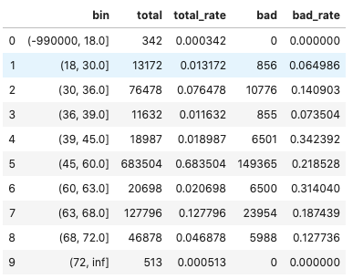
Week 14 成果汇报
不同 force_mono 参数
 | None | “one_turn” | “mono”
分箱数量 | 不强制任何单调性 | 最多允许 1 turn | 遇到头尾bad rate = 0 时有可能合并到剩下2箱

Slide 44
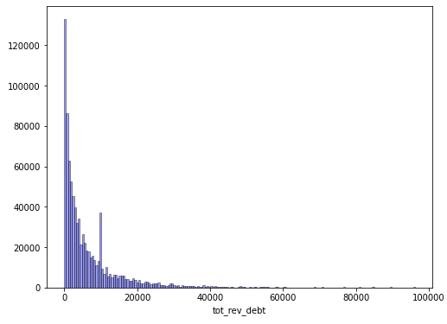
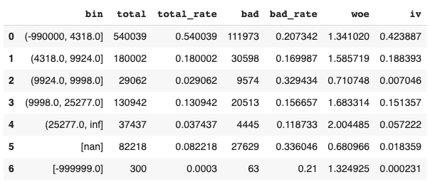
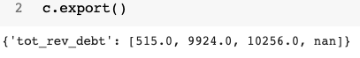
Week 14 成果汇报
实验：一种特殊的 missing value，-999999
新版本：
toad：

Slide 45
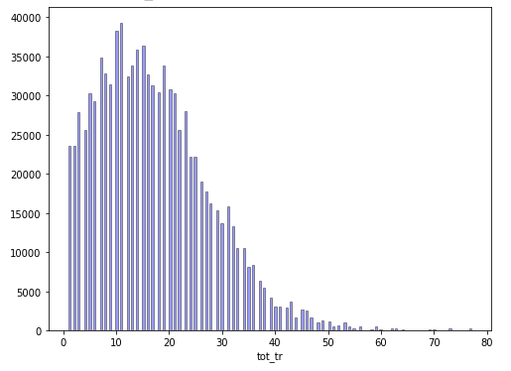
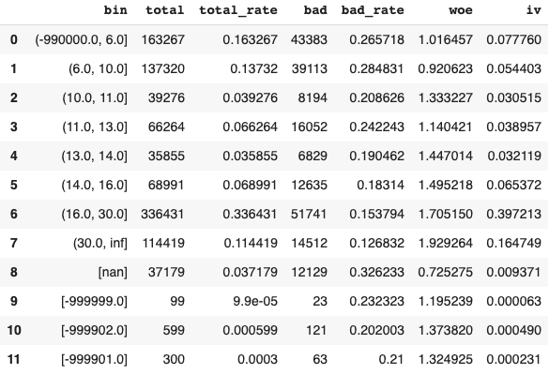
Week 14 成果汇报
实验：多种 missing value，nan, -999999, -999902, -999901
新版本：可以各自单独一箱
Toad：用户无法设定 missing_values

Slide 46
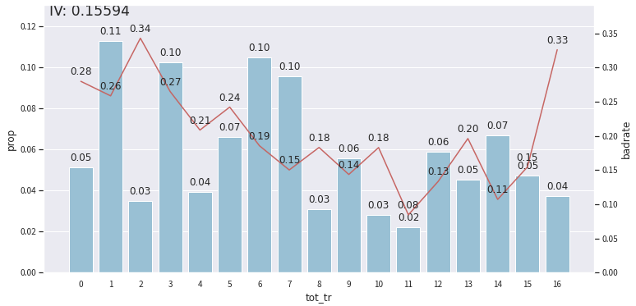

Week 14 成果汇报
实验: 单调性 force_mono = None, force_mono = “u_shape”, force_mono = “mono”
missing_values
→ toad
missing_values
新版本：

Slide 47


Week 14 成果汇报
实验: 单调性 force_mono = None, force_mono = “u_shape”, force_mono = “mono”
toad：
需要用户反复实验不同的n_bins 参数, fit( ) 多次来确定一个feature是否单调
但n_bins又会被套用在所有feature上
missing_values
missing_values
新版本：
根据 force_mono 合并
每个feature满足单调性就不再合并

Slide 48


Week 14 成果汇报
实验: 单调性 force_mono = None, force_mono = “u_shape”, force_mono = “mono”
toad：
需要用户反复实验不同的n_bins 参数, fit( ) 多次来确定一个feature是否单调
但n_bins又会被套用在所有feature上
missing_values
missing_values
新版本：
根据 force_mono 合并

Slide 49



Week 14 成果汇报
实验：手动分箱
toad：
新版本：会把原来发现的NA bins保留
可以recover 原来的分箱，不需要重新 fit

Slide 50




Week 14
Toad 使用经验: 当 feature nunique 过大时（eg > 5000），toad fit() 单个 feature 耗时很长
新版本：
toad：
method = “chi” 时，4000秒还没有跑完，建议用 “dt”

Slide 51
Week 14
分箱 performance
 | Toad fit | Toad transform | Helper fit chi_merge | Helper transform | Helper fit chi | Helper fit iv | Helper transform iv | Ft_eval fit | Ft_eval transform
Accept 1M all 23 features | 41.51 | 2.12 | 72.37 | 10.054 | 44.51 | 37.53 | 8.05 | 243.24 | 1046.24
df_score 1.1M all features (6 cat) | Set to (1000, 5000) t= 786.44 | 2.38 | 62.70 | 14.9 | 35.94 | 30.67 | 10.03
df_score 1.1M all features (6 cat) | Set to (100, 999) t= 23.66 | 2.42 | 59.55 | 14.81 | 32.51 | 28.77 | 9.78

Slide 52
Week 14
Technical details

Slide 53

Week 14 成果汇报
Step 0: extract bin bad_rates
LOOP:
Step 1: find turning points, and find count of turns
Break if count == 0 or 1 (from user)
Step 2: calculate difference in bad rates of turning points with neighbors
Step 3: find the min distance pair, and merge that 2 bins
Back to LOOP
Appendix：单调性 图解
bad_rate
bin_num

Slide 54

Week 14 成果汇报
Pseudo code：自下而上
def init_cat_bin(sr_feature, sr_y):
## find list_of_missing_values =
# ((values passed by user) UNION (default values: "nan", None)) intersect (unique categorical values from this feature)
df_na_bin = # df with bin column = list_of_missing_values
df_bin_interval = # df with bin column = the rest of unique values
return df_na_bin, df_bin_interval
## init with 2 df, 1 for missing value bins, 1 for normal value bins
df_na_bin , df_bin_interval = self.init_cat_bin(sr_feature, sr_y) # ---> function expanded:
if (len(df_bin_interval) < max_bin):
# no enough unique values, skip merging
else: # chi2 merge
## initial chi2 calculation
df_chi2 = self.calc_chi2_cat(df_bin_interval)

Slide 55
Week 14 成果汇报
Pseudo code：自下而上
else: # chi2 merge
## initial chi2 calculation
df_chi2 = self.calc_chi2_cat(df_bin_interval)
def chi2_merge(df_chi2):
while len(df_chi2) > min_bin:
idx_left, idx_right, min_chi2 = # find the min_chi2 pair of bins, in df_chi2, and their indexes
if min_chi2 > chimerge_threshold:
break
else ## merge the 2 bins
df_chi2 = self.merge_pair(idx_left, idx_right)
while max_bin < len(df_chi2):
## if bin count is > max_bin, merge the 2 bins with minimum chi2
return df_chi2.drop( columns of intermediate workings)
df_bin_interval = self.chi2_merge(df_chi2)
#sort the df by bad rate, so bad_rate will be monotonous
df_bin_interval = df_bin_interval.sort_values(by = ["bad_rate"])
# concat with the missing value bins
df_bin_interval = pd.concat([df_na_bin, df_bin_interval], axis=0)
df_bin_interval = # post processing to find woe, iv, total_rate and drop empty bins

Slide 56

Week 14 成果汇报
Pseudo code：自上而下
def init_cont(sr_feature, sr_y):
## find list_of_missing_values =
# ((values passed by user) UNION (default values: np.nan, None) UNION (unique values < -990000 in feature)) intersect (unique values in this feature)
df_na_bin = # df with bin column = list_of_missing_values
df_bin_interval = # df with bin column = the rest values, by equal distance / frequency
return df_na_bin, df_bin_interval
## init with 2 df, 1 for missing value bins, 1 for normal value bins
df_na_bin , df_bin_interval = self.init_cont(sr_feature, sr_y)
init_cat_bin( sr_feature, sr_y)
if (min_bin < len(df_bin_interval) < max_bin):
# no enough unique values, skip cutting
else: # start cutting
df_bin_interval = # add columns ["bin_temp", "score", "max_score_if_cut", "keep_cutting"] for cutting
keep_cutting = df_bin_interval.keep_cutting.sum() ## all 1

Slide 57
Week 4成果汇报
Pseudo code：自上而下
else: # start cutting
df_bin_interval = # add columns ["bin_temp", "score", "max_score_if_cut", "keep_cutting"] for cutting
keep_cutting = df_bin_interval.keep_cutting.sum() ## all 1
while keep_cutting:
for bin_num_temp in lst_current_bins:
## only try cutting if this temp bin is labelled keep_cutting == 1
if bin_num_temp has "keep_cutting" == 1 ("not set to 0 by lower methods"):
def cut_and_evaluate(df_bin_interval, bin_num_temp):
# find best cut point and the best score
best_cut_right, score = self.find_cut_point(df_bin_interval, bin_num_temp)
decide_cut_iv_entropy = ( (method=="iv" or method =="entropy") and score > old_score )
decide_cut_chi2 = (method == "chi" and score > self.chimerge_threshold)
if decide_cut_iv_entropy or decide_cut_chi2 or force_cut:
## cut the current temp bin at the best cut_point
## into bin_num_temp*2+1 and bin_num_temp*2+2, eg 3 will be come 7 and 8
else:
# set the "keep_cutting" of this part of df_bin_interval to 0
df_bin_interval.loc[df_bin_interval.bin_temp == bin_num_temp ,"keep_cutting"] = 0
return df_bin_interval
df_bin_interval = self.cut_and_evaluate(df_bin_interval, bin_num_temp)
keep_cutting = ( "some keep_cutting is still 1" and "length <= max_bin" )

Slide 58
Week 14 成果汇报
Pseudo code：自上而下
………… (cont.)
while len(df_bin_interval) > max_bin:
## force cut the df, while the length > than max_bin
df_bin_interval = self.cut_and_evaluate(df_bin_interval, bin_num_temp, force_cut = True)
df_bin_interval = # pandas groupby() to find bad, bad_rate, total, total_rate
df_bin_interval = # post processing to find total rate
if force_mono: # force monotone of bad rate
df_bin_interval = self.force_monotone(df_bin_interval, force_mono = force_mono)
## final merge with NA bins
df_bin_interval = pd.concat([df_bin_interval, df_na_bin], axis = 0).reset_index(drop = True)
## calculate woe and iv of each bin
df_bin_interval = self.calc_woe(df_bin_interval)
df_bin_interval = # drop bins where total count == 0

Slide 59
Week 14
Links to files
Demo codes | https://colab.research.google.com/drive/1A7opKZoNe2wcHaBU5F0b0AzoE4Jf13Rt?usp=sharing
Performance testing | https://colab.research.google.com/drive/1EK2lf-y787VAyY05Wkci44bniGkphwAx?usp=sharing
Pseudo codes + step by step runs | https://colab.research.google.com/drive/1XPnFxt86ydVJv7p1hjZiEtW2-Wxmjy3y?usp=sharing
Zip file of Class in .py file and .ipynb notebooks | https://drive.google.com/file/d/1IZLGClt1e6s6-uqDVdTnj01kBqNyMvZy/view?usp=sharing
full experiment outputs | https://drive.google.com/file/d/1bkhSBRX5pXdeyWx3DsuHdck4zap09At5/view?usp=sharing
Dataset | https://drive.google.com/drive/folders/1kJXregCKHTHrset803ymG93QxdXw-z9i?usp=sharing
Demo video | https://drive.google.com/drive/folders/1oV3KPLyNgGaODtCNYSJJuGg_XGyD1-2L?usp=sharing

Slide 60
Week 14 成果汇报
实验 + 手动分 OK
每一次 目的 内容 + data 构成 + 对比 toad 单调性画图 OK
经验 体会 - 精度（为什么慢） OK
Tech detail 放后面 OK
链接所有 OK
默认不将精度， 就算nunique value 太少， min_sample（0-1） 也要满足（默认单独一箱）
参数：strictly_min_sample / skip_init_small_nunique / merge_small_unique_bin
fit: n bins 改成 min_bin_size OK
Separate -- > merge_category OK
Init_method = “step” / “quantile” OK
Force_mono = “mono” / “u_shape” / None OK
Feature_list 逻辑 OK
transform() :
# feature_list OK
# exclude OK
# missing_values () OK

Slide 61
Week 14
下一步改进方向
在 init_cont() 中， 目前 -99xxxx 默认会识别成 missing value，有需要的话，设置一个参数选择是否识别
Gaussian ?

